Slide 1
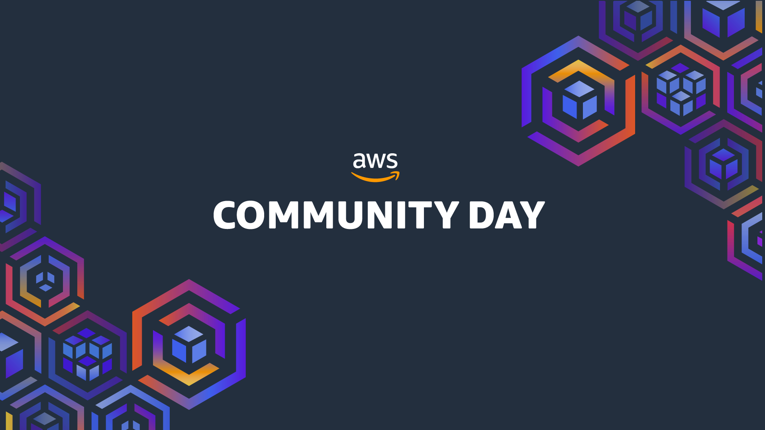
MALAYSIA
Notes:
Hi! Welcome to AWS Community Day Singapore 2025

Slide 2
From TF Bottleneck to CDK Breakthrough
Evolving Platform Without Starting Over
Zack & Vincent | 27 September 2025
Notes:
Hi Everyone, welcome to the next session!
This session is about modern tools and approaches towards infrastructure management
We will first provide an overview of how Infrastructure evolved over the years
Highlighting key drivers behind how this evolution happened
And provide an overview of the problem many organizations faced including us
Providing a demonstration of an approach we consider ideal

Slide 3

Speaker profile
Vincent
Cloud Platform Engineer
Community Organizer
Docker captain (2015 – 2017)
k8s Singapore (2016 - 2019)
CNCF HCMC (2022 – 2024)
Zack
Cloud Platform Engineer
Build secure, scalable AWS platforms with IaC
Owns cloud governance, cost control & guardrails
Notes:
In this section we will focus on how we evolved our IaC from classic Terraform to more advanced patterns leveraging the Cloud Development Toolkit and ecosystem.
We will highlight the bottlenecks we face (and often read about in community discussions) and the patterns we learned from to achieve this.
We will share his experience at Handshakes and how their team drove the adoption of the CDK & CDKTF tools without disruption of the existing Terraform based workflow.

Slide 4

Who is Handshakes?
Sensitive 3rd party data, strict compliance requirements
Team of 70+ Software engineers, 2 Platform engineers
Notes:
Title: Next-Gen Infrastructure as Code: Scaling Smart with CDKTF & TerraConstructs Subtitle: Real-world adoption at Handshakes.ai ✅ Introduce yourself, role, and what your team set out to solve 🕒 ~1 min
Key points:
Handshakes: AWS-native, Terraform-experienced startup
Mission: Empower product engineers to define infrastructure
Problem: HCL doesn’t scale well with team expectations

Slide 5

Timeline: Four Ages of Infrastructure
Iron Age (pre-2010)
Age of Sprawl (2016-2023)
Manual everything. Changes took weeks to plan and execute. Failure to anticipate needs was considered poor planning. Heavy processes slowed changes to manage risk.
Mainstream adoption. Digital disruption forced traditional industries to adapt or fail. Agile and DevOps became organizational imperatives, accelerated by COVID-19.
"Move fast and break things." Cloud accelerated change velocity. Used primarily by startups or teams operating outside traditional constraints.
Platform engineering era. Focus shifts to cost control, compliance, and empowering product engineers. "Infrastructure from Code" and AI-powered tools enable full stack ownership.
Shadow Age (2010-2016)
Sustainable Growth (2022-present)
Infrastructure as Code, Third Edition, Ch03
Notes:
Ref: https://speakerdeck.com/so0k/integrate-this?slide=4

Slide 6
Why yesterday’s IaC stops short Today
> Rapid evolution of cloud platforms exposed limitations
Static Templates insufficient
Sheer volume and dynamic nature of cloud services overwhelms static YAML or HCL templates.
Modern Patterns Demand More
Serverless, Containers, event driven… requires composition, iteration and code reuse beyond
Declarative-Only Pain Points
Conditional logic, reuse, testing, and debugging are clumsy – increase cognitive load.
Organizational Shifts amplify gap
Rise of platform engineering and “you build it, you run it” expects self-service golden paths, not tickets for specialists.
Notes:
Slide 3 — Why yesterday’s IaC stops short today
Infrastructure-as-Code (IaC) revolutionized how we manage infrastructure, shifting from manual configuration to declarative definitions.
However, the rapid evolution of cloud platforms and modern application architectures has exposed limitations in traditional IaC approaches.
Cloud complexity outgrew static templates
Cloud product lines exploded; service combinations and churn create coupling to app logic that YAML/HCL struggle to model cleanly. (Thoughtworks: cloud “line items … now exceeds 2M products”.) (Thoughtworks)
Modern patterns amplify the gap
Serverless, containers, event-driven topologies need composition, iteration, and code reuse beyond what static templates offer. (Thoughtworks)
Platform Engineering expects self-service golden paths, not tickets for specialists. (Thoughtworks)
You build it, you run it pushes product teams to own infra changes as part of delivery. (Werner Vogels, 2006.) (queue.acm.org)
Declarative-only pain points Conditional logic, reuse, testing, and debugging are clumsy; manifest sprawl and indirection increase cognitive load. (K8s/YAML: “declarative complexity” and limited reusability.) (Medium)
Application-Driven Infrastructure (Kief Morris) Design infra from the app workflow back, componentized and deployed via application pipelines — a shift beyond hand-crafted stacks. (Thoughtworks)
New accelerants AI code generation (e.g., v0.dev, bolt.new) reduces boilerplate and accelerates scaffolding for platform “golden paths,” while still requiring safe guardrails. (UI Bakery)
Set up the demo “Setting up every resource is painful — component libraries abstract patterns so teams compose outcomes, not primitives.” (Segues to Slide 4.)

Slide 7
Why General-Purpose Languages for IaC Now?
> Leverage existing programming skills (TS/JS, Python, Go, C#, Java, …)
Familiarity & Lower Barriers
Reuse skills, IDEs, test runners, package managers
Richer Composition
Real functions, modules, types and loops enable Component Libraries encoding best practices
Higher Level Patterns
Leverage cross-cutting interfaces (for permissions, networking, …) abstracting infra concerns
Platform & Ownership Alignment
Teams ship infra via SDK-like building blocks Great fit for self-service platforms and product teams owning runtime outcomes
Notes:
Slide 4 — Why general-purpose languages (GPLs) for IaC now
Familiar languages lower the barrier Use TS/JS, Python, Go, C#, Java for infra — reuse skills, IDEs, test runners, package managers. (Pulumi; CDK for Terraform.) (pulumi)
Richer composition > static templating Real functions, modules, types, and loops enable component libraries that encode best practices once and reuse broadly. (Pulumi on GPL benefits.) (pulumi)
Bridge to existing ecosystems, not a rip-and-replace CDKTF compiles to Terraform plans, keeping state, policies, workflows, and registries intact — ideal for gradual adoption. (HashiCorp Developer)
Higher-level patterns out of the box The CDK family demonstrates cross-cutting interfaces and asset pipelines (e.g., IGrantable, IConnectable) that encode permissions, networking, and packaging concerns. (AWS CDK APIs.) (AWS Documentation)
Aligns with Platform Engineering & YBIYRI Teams ship infra via SDK-like building blocks — great fit for self-service platforms and product teams owning runtime outcomes. (Thoughtworks)
Tradeoffs & mitigations
Still need cloud/domain knowledge — but IDEs, types, and refactoring make discovery and safety nets stronger. (pulumi)
Maintenance shifts to library authors — treat infra components as products. (Thoughtworks)
LLMs can assist selection/configuration of components; done within code and policy controls, this avoids risky ClickOps. (Thoughtworks)
Prime the live demo Show: asset pipeline, strongly-typed constructor props/enums, imperative methods to express intent, and cross-cutting traits — then reveal the generated Terraform under the hood to prove it slots into today’s governance and pipelines. (HashiCorp Developer)

Slide 8
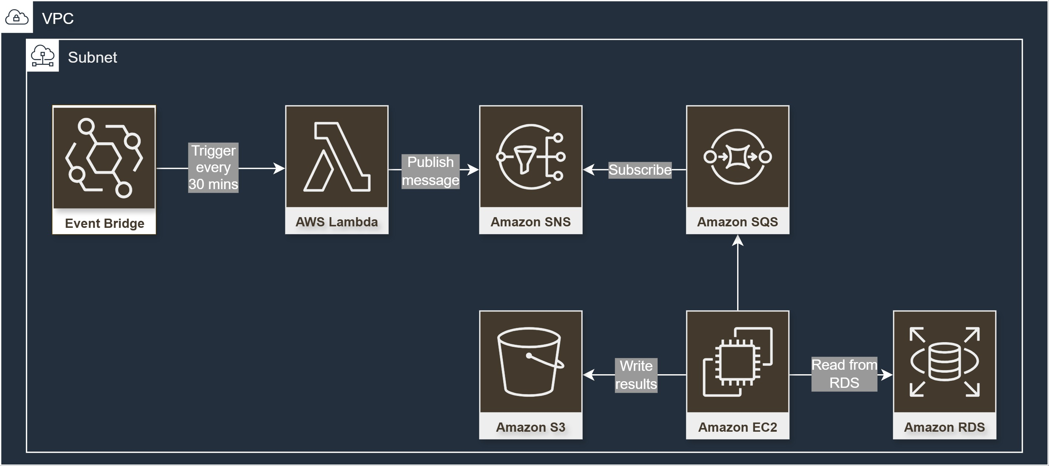
Example CDK UX for
Notes:
Leverage cloud, building on
Cloud native
Event driven
Serverless pipeline
Designed for rapid scale, operational simplicity
Next, I will do a live demo on how to create this robust event-driven pipeline using a higher construct easily

Slide 9
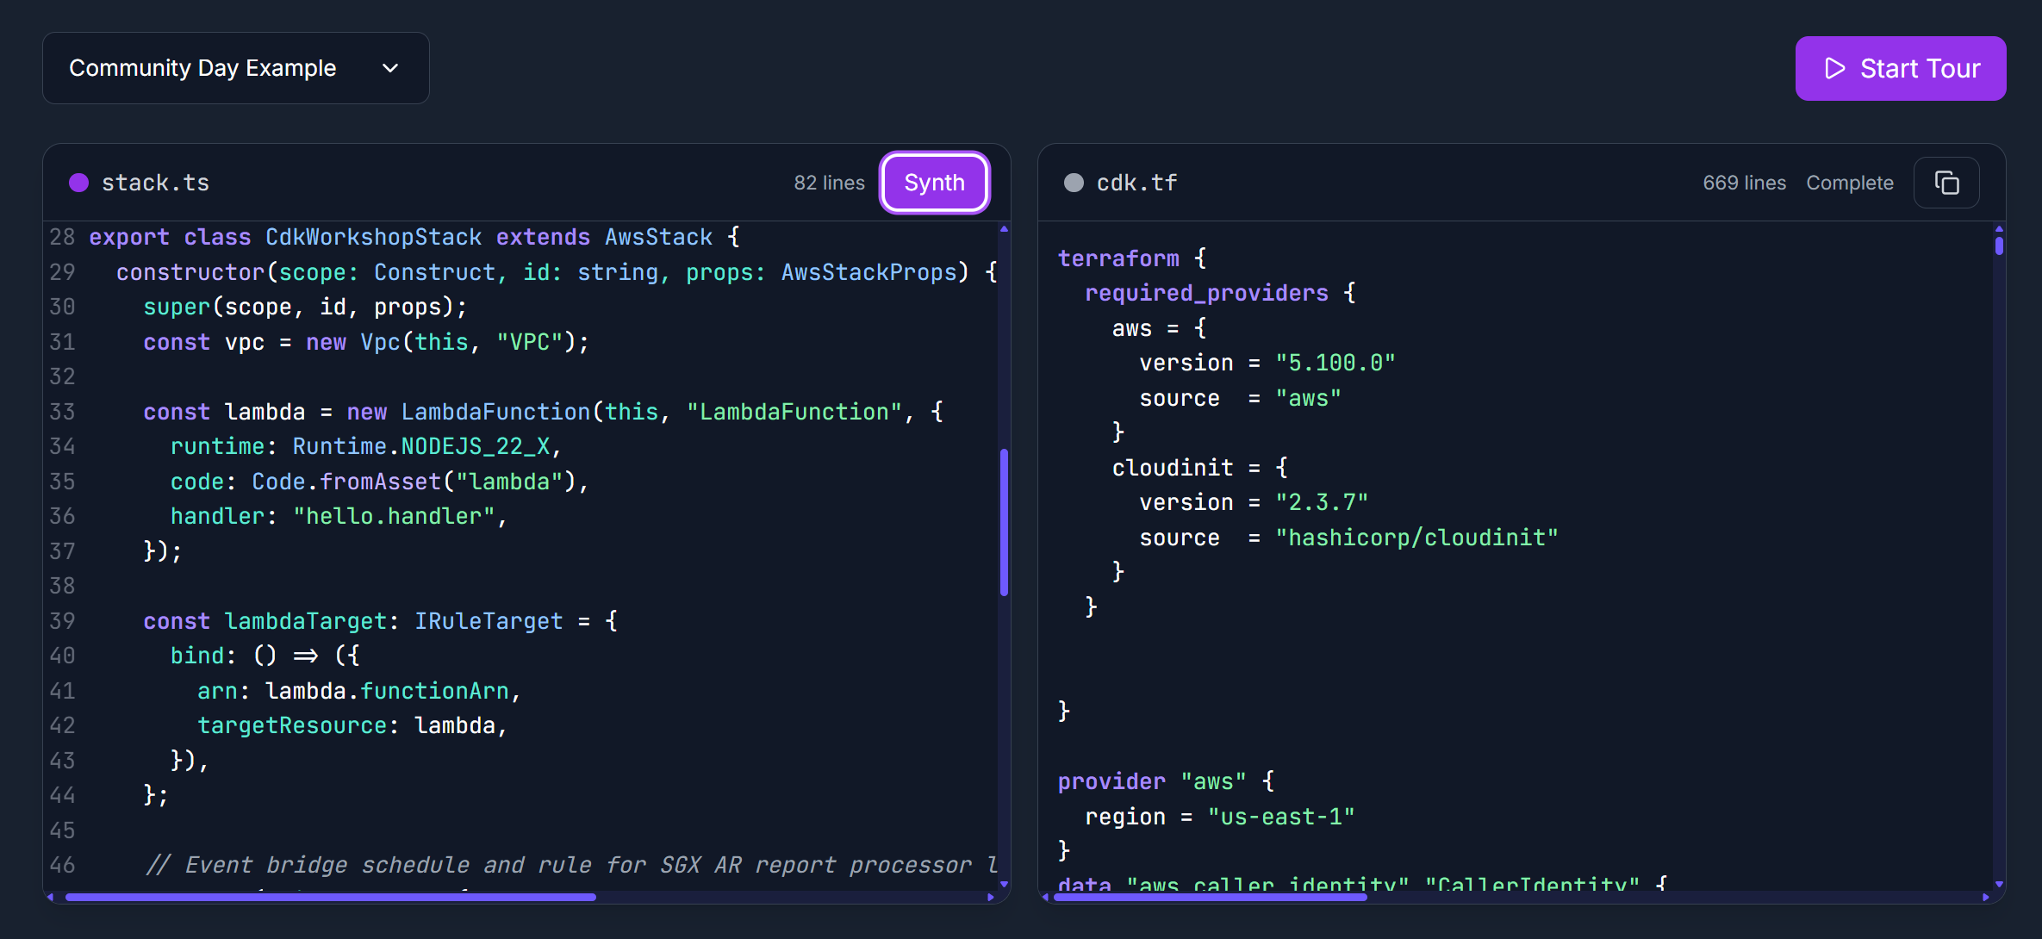
Live Demo
Notes:
Running a local copy of https://terraconstructs.dev/#demo

Slide 10
Example CDK UX

Slide 11
Our IaC Journey to CDK Breakthrough
Establish Terraform with advanced workflows and tooling
CDKTF Adoption Leveraging TypeScript while maintaining TF workflows
2021
2024
2023
2025
Scaling Challenges Product engineers needed HCL expertise; platform team bottleneck
TerraConstructs Bringing AWS CDK-like abstractions to TF
Notes:
High level overview of the timeline (outlines the structure of this presentation) - do NOT go into details of each milestone as this is covered in the presentation.
Cloud Adoption Journey really started around 2021 with Terraform, establising a strong backbone.
As Terraform adoption spread across the origanisation we hit scaling issues quite quickly
Early stage a preference for General Purpose languages had our Product teams gravitate towards CDKTF
Which brings us to today, as we build a higher level, fully open source, library of constructs to bring AWSCDK like abstractions to Terraform

Slide 12
Strong existing Terraform backbone
3+ Years of Terraform (automation, linting, policy as code, …)
Custom HCL Template engine: golang CLI (fogg)
Packer atlantis AMI for trunk based PR Automation
Full e2e AMI validations using terratest
OPA Policies (conftest) automatically ran on TF Plans
Integrated tfmigrate for declarative TF State refactoring (critical for adapting to org structure and product changes)
Notes:
Title: The Terraform Backbone 🕒 ~1.5 min
Message: A mature, automation-rich Terraform ecosystem was already in place. Bullet points:
3+ years with Terraform
Golang CLI to bootstrap IaC folders
Atlantis for trunk-based PR automation
Conftest for policy-as-code
Flexible state refactoring critical for adapting to product needs 🔍 Why we were reluctant to replace it.
Title: HCL Doesn’t Scale with Team Ownership 🕒 ~1.5 min
Message: Product engineers faced barriers working directly in Terraform modules. Bullet points:
HCL exposed to product engineers: hard to read, debug, and extend
Platform team (2 people!) had to implement and maintain all first-gen modules
Engineers couldn’t easily integrate AWS services themselves 📉 Friction + bottleneck = not scalable

Slide 13
Why We Needed Something Better
The Terraform Bottleneck
Product engineers had shared responsibility for AWS resources, but:
Limited by HCL's flexibility
Lacked modern debugging tools
Poor IDE Integration
Platform team (just 2 people) + TF Modules became a bottleneck for new requirements or exploring AWS Services
Notes:
Title: HCL Doesn’t Scale with Team Ownership 🕒 ~1.5 min
Message: Product engineers faced barriers working directly in Terraform modules. Bullet points:
HCL exposed to product engineers: hard to read, debug, and extend
Platform team (2 people!) had to implement and maintain all first-gen modules
Engineers couldn’t easily integrate AWS services themselves 📉 Friction + bottleneck = not scalable
TF Modules: either in-house or public community, they are always a pain to adopt due to the low level exposure the to the AWS service API Resources and terrible DevX exposed by them.
We would often need to piece together the disparate input variables and step down into several layers of local block indirections to figure out how the input variables were consumed and exactly how we had to get the combination just right for our use case (too often things would be brittle and difficult to get right, without a proper way to step through or evaluate how the generated terraform plan came about...
The internal terraform configuration has too many conditionals and branching to even understand how it's supposed to work.
Copy pasting the pieces we wanted to internal modules and iterate on them over time would result in a similar hard to maintain internal module. This is a common problem we see in the TF ecosystem.

Slide 14

Team preference for General Purpose Programming Languages
CDKTF
AWS CDK
CLI for Terraform execution
CLI for CloudFormation orchestration
L1 Constructs from TF Providers
L1 Constructs from CFN Resources
Basic Assets pipeline
Advanced Asset pipeline includes bundling
deploy-time AWS lookup support only
synth-time AWS Lookup support
Auto-generators for TF Modules (basic)
L2 Constructs with service integration
Advanced patterns IGrantable, IConnectable, etc …
Re-use Terraform State & Workflows
No shared state backend
Notes:
Title: CDKTF vs AWS CDK: Where CDKTF Falls Short 🕒 ~1.5 min
Message: CDKTF didn’t fully match the AWS CDK’s high-level abstractions. Bullet points:
TF module wrappers still expose raw inputs/outputs
Lack of constructs like IGrantable, IConnectable
No rich AWS-specific L2 constructs
Product engineers still had to deal with Tokens, for_each, etc. 😕 It felt like “CDK in theory, HCL in practice”

Slide 15




Benefits of CDKTF for Handshakes
Intuitive Language write IaC in TypeScript with loops, conditionals & classes for reusable patterns
Reuse
Keep all TF modules, providers, TF bootstrapping and automation
Gradual Migration
Convert one module at a time while sharing and interacting with same state backend
Multi-Provider Support
Manage AWS, GitHub, Datadog, … in the same "App" and/or "Stack".
Notes:
Title: CDKTF: The Missing Developer Bridge 🕒 ~2 min
Message: CDKTF brought flexibility without throwing out Terraform. Bullet points:
Write Terraform in TypeScript
Reuse existing Terraform modules
Seamlessly integrates with Terraform plan/apply, state backends, Atlantis
Gradual migration: one module at a time
Use loops, conditions, libraries, tests → more dev-friendly ✅ Lower barrier for product teams

Slide 16
Why Not AWS CDK
Full Migration Required Complete rewrite with no direct use of existing TF code
CloudFormation Lack of Operational Experience, slower deployments, resource limits, feature gaps
Refactoring Challenges Resource renaming can trigger unwanted replacements
Loss of Plan Workflow Preference for existing Terraform clear plan/apply cycle
AWS-Only Focus Limited to AWS resources, unlike Terraform's multi-cloud support
Notes:
Why We Didn't Switch to AWS CDK 🕒 ~1.5 min
Message: The migration cost was too high and trade-offs too steep. Bullet points:
Full rewrite + CloudFormation limitations
No reuse of Terraform state/modules
Lack of multi-cloud support (e.g., Datadog, GitHub)
No plan output, drift detection weaker
Renames = resource replacements 💥 Too risky for a Terraform-native team

Slide 17
CDKTF Limitations We Discovered
Wrapper Limited Type System
TF Module wrappers still had limited typing for inputs and no typing for outputs
Implementation "Leaks"
Product engineers still exposed to for_each and iterator concepts
No High-Level Patterns
Missing AWS-specific constructs (L2) that auto-configure common patterns
in practice: CDKTF alone did not significantly improve the product engineer experience

Slide 18
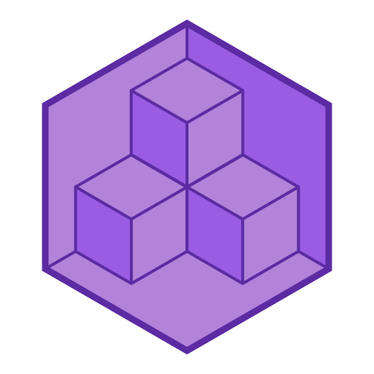
TerraConstructs
https://terraconstructs.dev
Notes:
Title: TerraConstructs: CDKTF with AWSCDK Power 🕒 ~2 min
Message: TerraConstructs brought the missing L2 magic to CDKTF. Bullet points:
Open-source, Apache 2.0 licensed
Adds rich AWS constructs to CDKTF (like aws-cdk-lib does for AWS CDK)
Encapsulates complex patterns (e.g., Lambda + API Gateway + IAM)
Still uses Terraform under the hood
Works with existing Terraform CI/CD pipelines 🎯 Best of both worlds: AWS CDK-like DX with Terraform compatibility

Slide 19

The Missing Piece: TerraConstructs
Open source library that brings "AWS CDK"-like abstractions to CDKTF
Quickly closing the gap to cover AWS Resources we (Handshakes) need.
Retains all Terraform Benefits
Contributions Welcome! 🎉
terraconstructs.dev
TerraConstructs bridges the gap between CDKTF flexibility and AWS CDK Abstractions
Notes:
@Vincent: UPDATE QR CODE TO LANDING PAGE
We just started building this open source library and if you're interested
Where is the adoption of TerraConstructs path and how does it look like at Handshakes.
Title: TerraConstructs: CDKTF with AWSCDK Power 🕒 ~2 min
Message: TerraConstructs brought the missing L2 magic to CDKTF. Bullet points:
Open-source, Apache 2.0 licensed
Adds rich AWS constructs to CDKTF (like aws-cdk-lib does for AWS CDK)
Encapsulates complex patterns (e.g., Lambda + API Gateway + IAM)
Still uses Terraform under the hood
Works with existing Terraform CI/CD pipelines 🎯 Best of both worlds: AWS CDK-like DX with Terraform compatibility

Slide 20
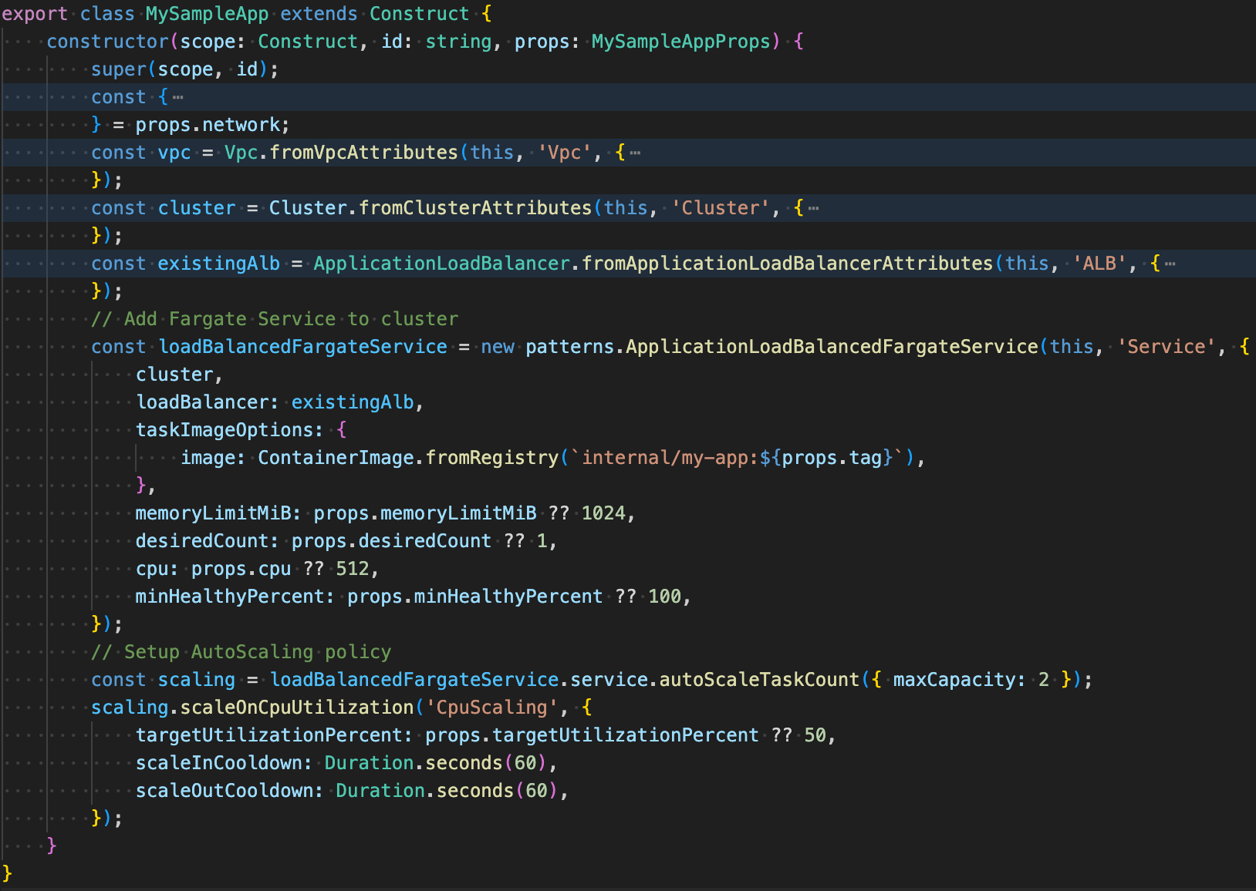
L2 Pattern Practical Example
Environment Integration
Reusable Patterns**
.. with intent oriented API
** pending "ECS patterns" module public release
Notes:
Quick recap of what it looks like to use these higher level abstractions for our product engineers
In the next few slides we will focus on this example of an ECS Service backed by a Fargate Capacity Provider to deploy autoscaling containers
We will integrate into several different environment where a “Landing Zone” has been provisioned by the networking / platform team, providing the VPC, shared ECS cluster (with preconfigured provisioners) and existing Ingress Load Balancers and target groups.

Slide 21
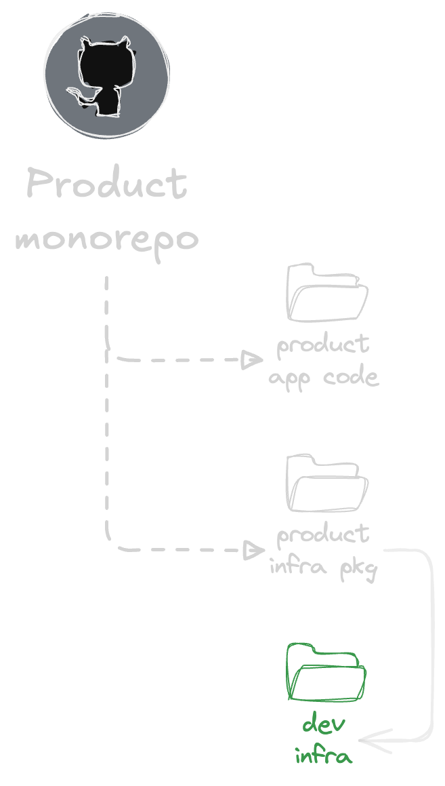
Our Workflow Integration
Best in class, developer ecosystem standards turbo.repo, pnpm.io, changesets, …
in-repo "Dev Infra" accessible (see next ...)
Notes:
Now how does the development workflows practically look like for our Product Engineers?
They define their infra needs (using component library) right next to their product code
Re-using the tooling they are most familiar with in their ecosystem, for us this is Javascript
Best in class tools such as TurboRepo for monorepo task running, Pnpm for workspaces across the monorepo and ChangeSets to automate semantic version bumps, changelog generation and release workflows
Because infra is defined as a package in repo, they can evolve it as needed by their product features

Slide 22
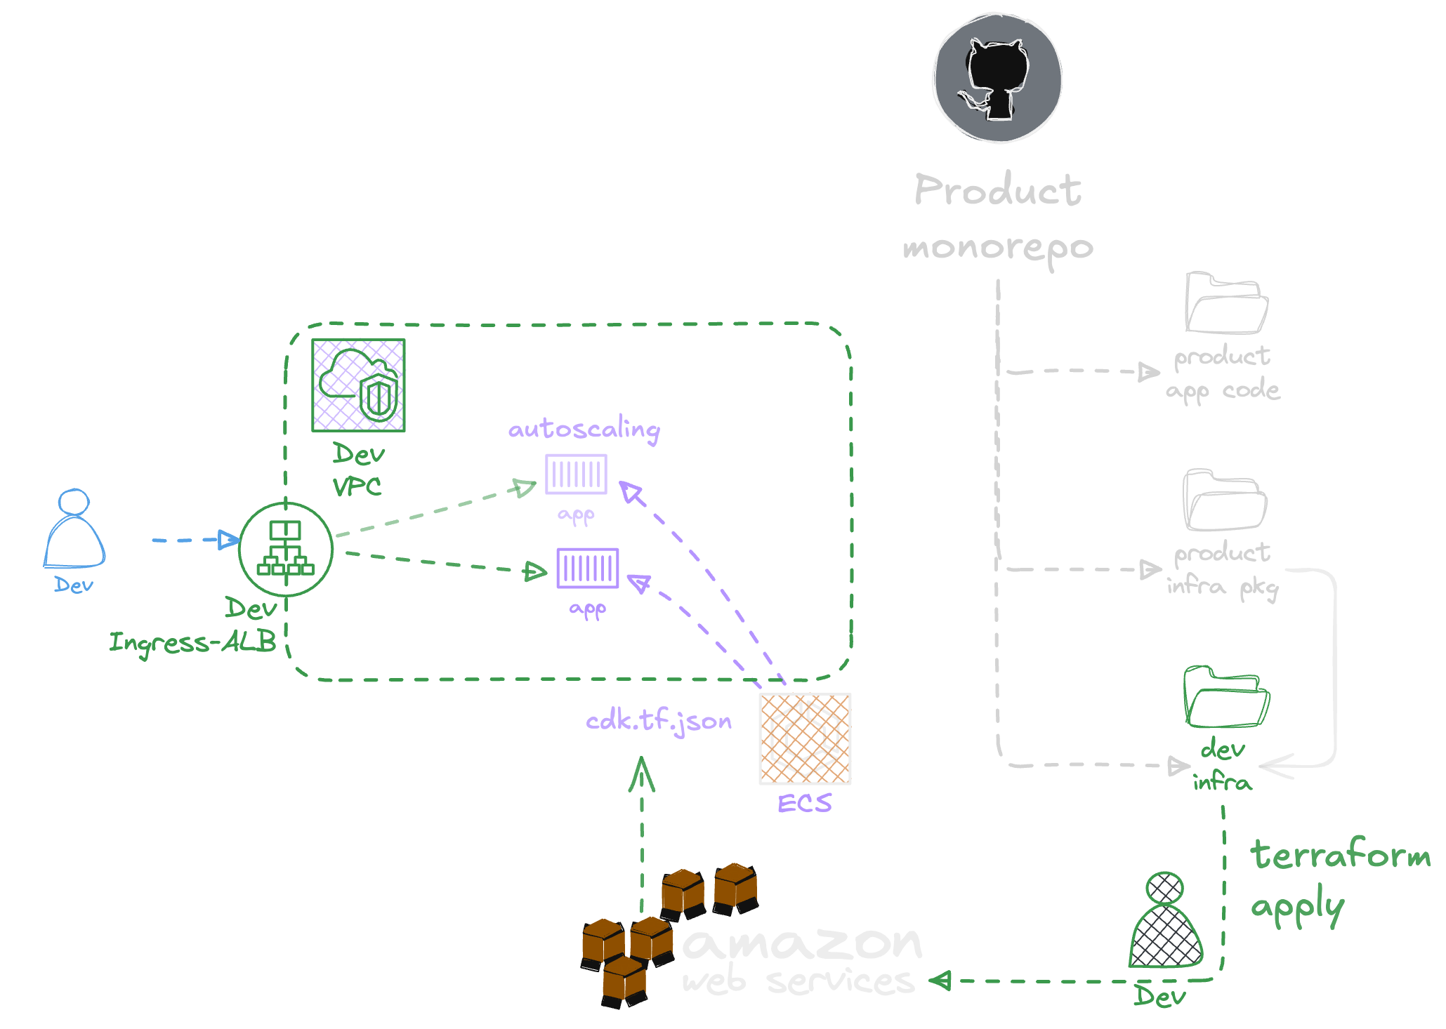
Our Workflow Integration
Developer iterate on IaC directly to Dev
Notes:
Product engineers can deploy to development environments directly from their product repos (and stand up any version of services with changes required for the new feature they’re working on)
Here we see the autoscaling ECS Fargate pattern integration with existing Vpc / Ingress Load Balancers. CDKTF Package deployment into the Development environment
where the developers themselves can validate the new feature integration
The cloud is an extension to their laptop (we all know we can’t fully replicate AWS on our local laptop with most of these cloud services).

Slide 23
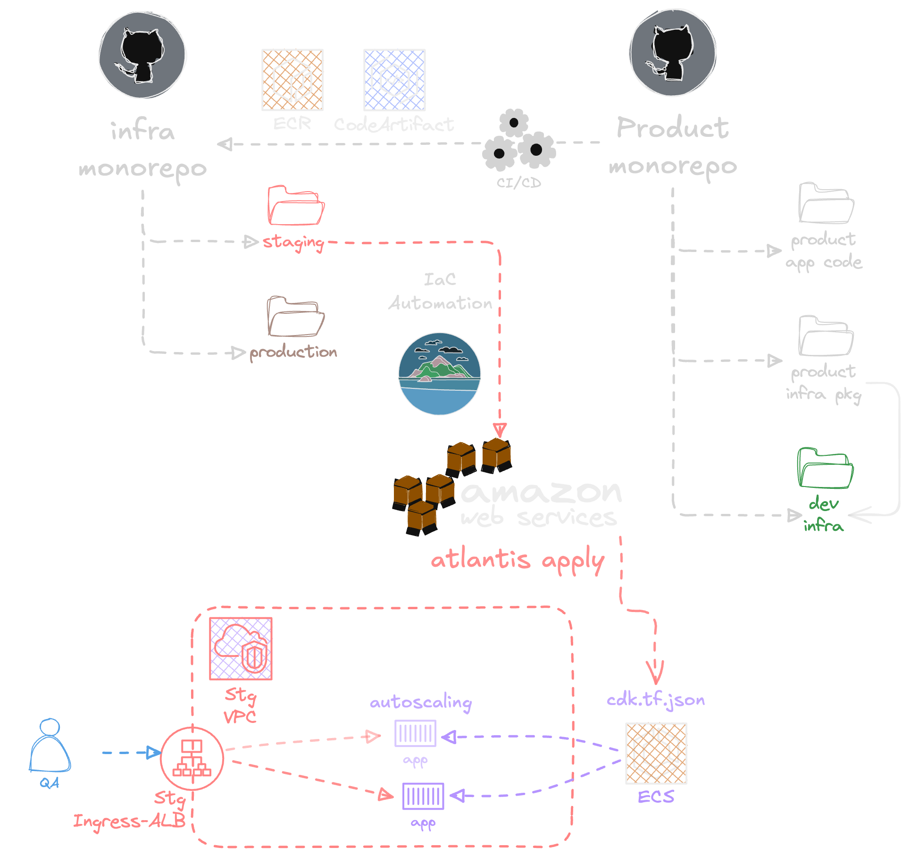
Our Workflow Integration
Well known CI/CD Release & Publish workflows
Standard Artifact Repositories (unlike niche tf module registries)
Controlled Staging Deployments for environment integration
Notes:
Once the developers have validated the new feature development against the dev environment and they are confident to cut a versioned release
They can do so with:
Well known CI/CD release and publish workflows (using ChangeSets as highlighted earlier)
STANDARD artifact repositories (ECR , AWS CodeArtifact, …) so the same methodology is used to publish the Code package and the Infra package)
Finally doing a GATED deployment into the INTEGRATION monorepo for the staging environment
Where QA validations are done against full integrations on the way to production
Integration test, Regression test

Slide 24
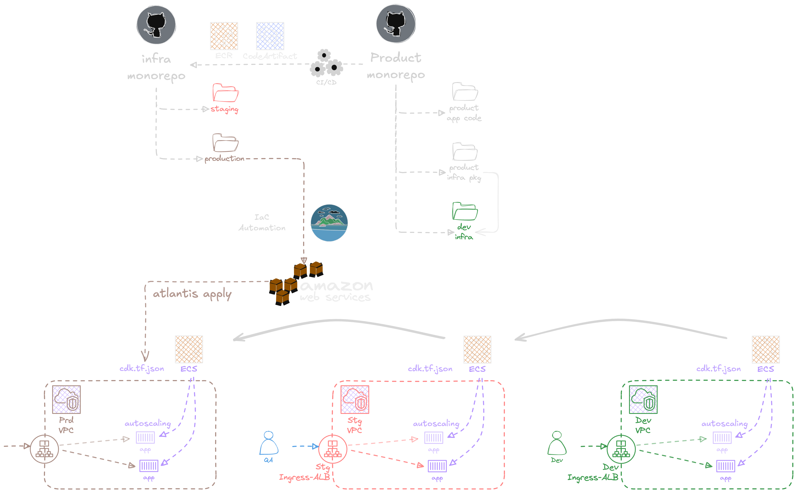
To production
Notes:
And Finally all the way to production
Within the Integration, the Infra monorepo staging environment configuration of the different product package versions we are consuming from the product teams (application driven infrastructure style), we are promoting these into production environment
Monorepo here gives us full reference between staging and production
We are not saying this is the “Right way”, this is the way we found works best for our company size, the organization of our teams and product code they develop.

Slide 25
Team Collaboration
Shared language between platform and application teams More IaC contributions
1
Gradual Adoption
Refactor portions of HCL while keeping existing workflows
2
Standardization
Codify requirements into reusable Constructs
3
Developer Experience
"AWS CDK"-like abstractions with familiar Typescript/Python
4
🎯 Terraform + CDKTF + TerraConstructs = Scalable, Smart IaC
Notes:
Title: CDKTF + TerraConstructs at Handshakes.ai 🕒 ~1 min
Message: Developers write high-level IaC, we keep Terraform orchestration. Bullet points:
Product teams use intuitive constructs
Platform team owns the shared construct library
PR automation (Atlantis) works unchanged
Gradual refactor of HCL to CDKTF 🛠️ No parallel systems, just incremental modernization
Title: How TerraConstructs Changes the Game 🕒 ~1 min
Message: Constructs become a shared language across teams. Bullet points:
Platform team defines reusable, standardized patterns
Product teams compose infra using those constructs
No silos: both use TypeScript, test infra, review in PRs
TerraConstructs’ roadmap promises even broader AWS coverage 🔗 Collaboration improves, consistency follows

Slide 26
Modernize Terraform without starting over
✅ Keep your terraform state, modules and workflows
✅ Empower developers with code-first IaC
✅ Avoid the migration pain to other frameworks
✅ Standardize Architecture through reusable constructs
Notes:
Title: Modernize Terraform Without Starting Over 🕒 ~1 min
Message: CDKTF + TerraConstructs lets you evolve, not replace. Bullet points: ✅ Keep your Terraform state, modules, and workflows ✅ Empower developers with code-first IaC ✅ Avoid the migration pain of AWS CDK ✅ Standardize architecture through reusable constructs 🎯 Terraform + CDKTF + TerraConstructs = Scalable, Smart IaC

Slide 27

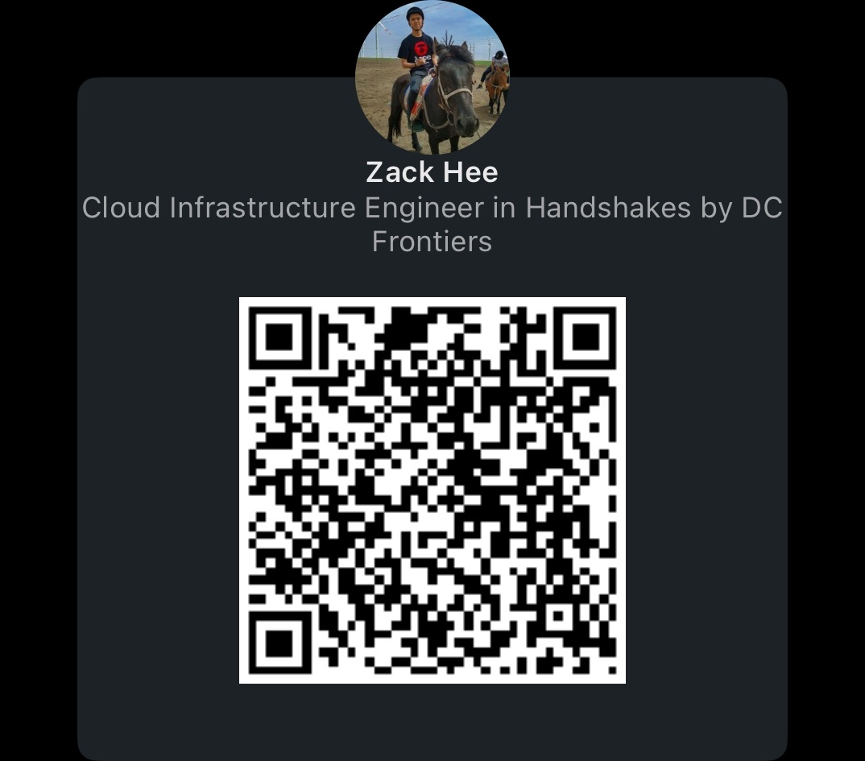
If you want to know more about us!
Notes:
Title: Modernize Terraform Without Starting Over 🕒 ~1 min
Message: CDKTF + TerraConstructs lets you evolve, not replace. Bullet points: ✅ Keep your Terraform state, modules, and workflows ✅ Empower developers with code-first IaC ✅ Avoid the migration pain of AWS CDK ✅ Standardize architecture through reusable constructs 🎯 Terraform + CDKTF + TerraConstructs = Scalable, Smart IaC

Slide 28
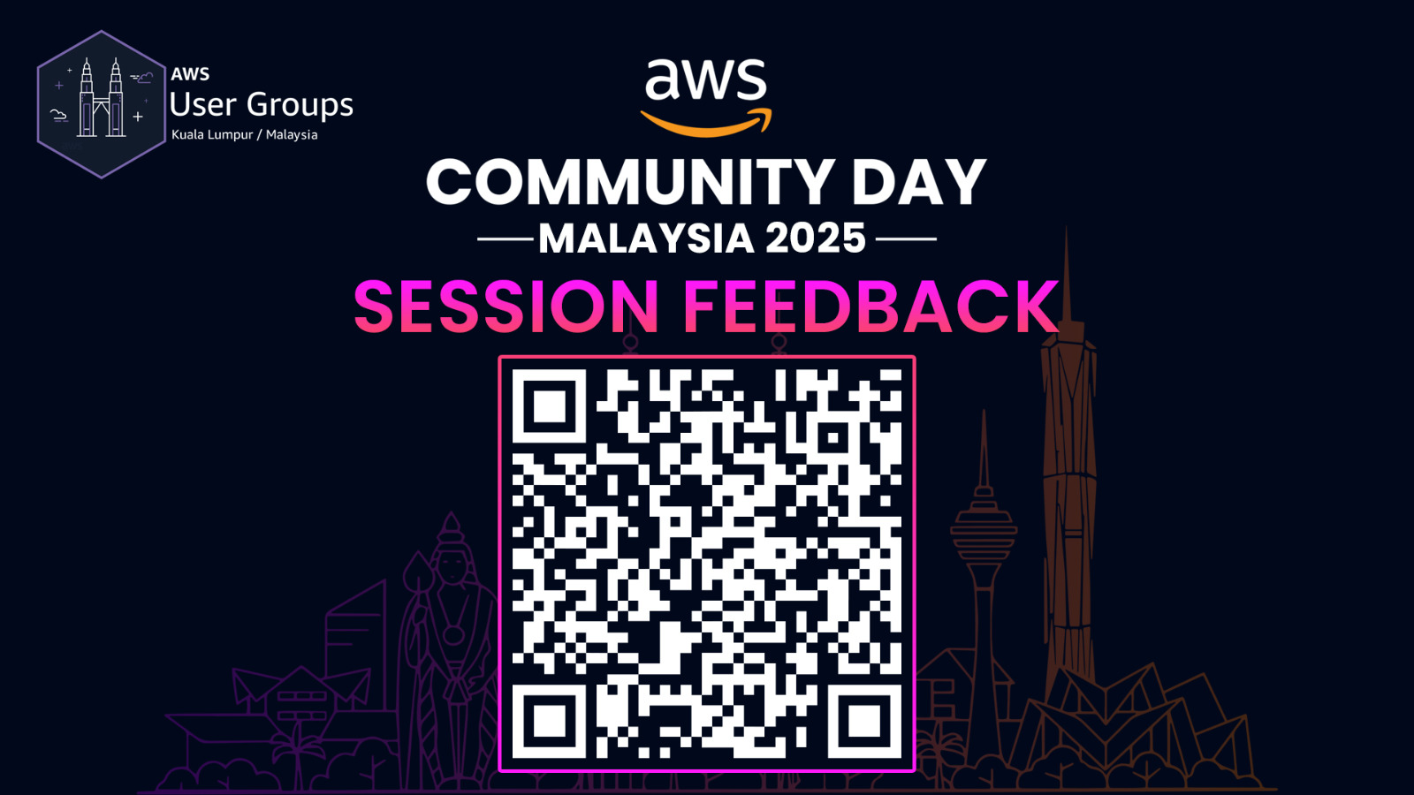

Slide 29

Do the Workshop!
aws-workshop.terraconstructs.dev

